Slide 1
Module-I: NETWORK THEOREMS(DC & AC EXCITATIONS)
Superposition theorem
Thevenin’s theorem
Norton’s theorem,
Maximum power transfer theorem
Reciprocity theorem
Compensation theorem
Milliman’s theorem
Concept of duality and dual networks.

Slide 2
TEXT BOOKS
William Hayt and Jack E.Kemmerley, “Engineering Circuit Analysis” ,Mc Graw Hill Company, 8th edition,2015.
C.L.Wadhwa, “Network Analysis And Synthesis”, New Age International publication, 3rd edition,2018.
Charles K Alexander, Mathew. N. O.Sadiku, “Fundamental of Electric Circuits”, Tata McGraw- Hill ,6th edition,2019.

Slide 3
Superposition Theorem
Module-I: NETWORK THEOREMS(DC & AC EXCITATIONS)
Network theorems are used to reduce a complex circuit to a simpler one, thereby making circuit analysis much simpler
The superposition principle states that the voltage across (or current through) an element in a linear circuit is the algebraic sum of the voltages across (or currents through) that element due to each independent source acting alone.
The principle of superposition helps us to analyze a linear circuit with more than one independent source by calculating the contribution of each independent source separately. However, to apply the superposition principle, we must keep two things in mind:
We consider one independent source at a time while all other independent sources are turned off. This implies that we replace every voltage source by 0 V (or a short circuit), and every current source by 0 A (or an open circuit).
Dependent sources are left intact because they are controlled by circuit variables.

Slide 4
Steps to Apply Superposition Principle:
Step1:Turn off all independent sources except one source. Find the output (voltage or current) due to that active source
Step2:Repeat step 1 for each of the other independent sources.
Step3:Find the total contribution by adding algebraically all the contributions due to the independent sources.

Slide 5
Use the superposition theorem to find v in the given circuit

Slide 6
Find i_{o} in the given circuit using superposition
Deactivate 20V voltage source
apply mesh analysis in order to obtain io′ . For loop 1,
i1 = 4 A
For loop 2,
For loop 3,
But at node 0,
To obtain i″o, we turn off the 4-A current source so that the circuit becomes
For loop 4, KVL gives
For loop 5, KVL gives
But i5 = −i″o. Substituting this
Using superposition principle:

Slide 7
Exercise Problem1: Using the superposition theorem, find vo in the circuit

Slide 8
Exercise Problem2: For the given circuit, use the superposition principle to find i.
12V voltage source is acting alone
24V voltage source is acting alone
3A current source is acting alone

Slide 9
Exercise Problem3: Find v_{x} in the given circuit

Slide 10
Use the superposition theorem to find Io in the circuit
Voltage source is acting alone
Current source is acting alone
From mesh 1
From mesh 2
From mesh 3

Slide 11
Exercise Problem4: For the given circuit, use the superposition principle to find v_{o}.

Slide 12
Thevenin’s Theorem-DC
It often occurs in practice that a particular element in a circuit is variable (usually called the load) while other elements are fixed.
As a typical example, a household outlet terminal may be connected to different appliances constituting a variable load.
Each time the variable element is changed, the entire circuit has to be analyzed all over again.
To avoid this problem, Thevenin’s theorem provides a technique by which the fixed part of the circuit is replaced by an equivalent circuit.
Thevenin’s theorem states that a linear two-terminal circuit can be replaced by an equivalent circuit consisting of a voltage source V_{Th} in series with a resistor R_{Th}, where V_{Th} is the open-circuit voltage at the terminals and R_{Th} is the input or equivalent resistance at the terminals when the independent sources are turned off.

Slide 13
If the terminals a-b are made open-circuited (by removing the load), no current flows, so that the open-circuit voltage across the terminals a-b in the circuit must be equal to the voltage source V_{Th}
V_{Th} is the open-circuit voltage across the terminals that is, V_{Th} =V_{OC}
With the load disconnected and terminals a-b open circuited, we turn off all independent sources.
The input resistance (or equivalent resistance) of the dead circuit at the terminals a-b must be equal to R_{Th}.

Slide 14
Find the Thevenin equivalent circuit of the circuit shown in Figure, to the left of the terminals a-b. Then find the current through R_{L} = 6, 16,and 36 Ω.
We find R_{Th} by turning off the 32-V voltage source (replacing it with a short circuit) and the 2-A current source (replacing it with open circuit). The circuit becomes
To find V_{Th}, remove load resistance. Applying mesh analysis to the two loops, we obtain
Applying mesh analysis to the two loops, we obtain

Slide 15
Exercise Problem 5: Using Thevenin’s theorem, find the equivalent circuit to the left of the terminals in the circuit

Slide 16
Norton’s Theorem-DC
Norton’s theorem states that a linear two-terminal circuit can be replaced by an equivalent circuit consisting of a current source I_{N} in parallel with a resistor R_{N}, where I_{N} is the short-circuit current through the terminals and R_{N} is the input or equivalent resistance at the terminals when the independent sources are turned off
Relation between Thevenin’s and Norton’s Theorems
To determine the Thevenin or Norton equivalent circuit requires that we find:
The open-circuit voltage voc across terminals a and b.
The short-circuit current isc at terminals a and b.
The equivalent or input resistance Rin at terminals a and b when all independent sources are turned off.
RN = RTh

Slide 17
Find the Norton equivalent circuit of the given circuit

Slide 18
Exercise Problem 6: Find the Thevenin’s and Norton’s equivalent of the given circuit

Slide 19
Find the Thevenin’s and Norton’s equivalent of the given circuit

Slide 20
Exercise Problem 7: Find the Thevenin’s and Norton’s equivalent of the given circuit

Slide 21
Maximum Power Transfer Theorem (DC)
In many practical situations, a circuit is designed to provide power to a load.
There are applications in areas such as communications where it is desirable to maximize the power delivered to a load.
The Thevenin equivalent is useful in finding the maximum power a linear circuit can deliver to a load.
We assume that we can adjust the load resistance R_{L}.
If the entire circuit is replaced by its Thevenin equivalent
except for the load, as shown in Fig., the power delivered to the load is
For a given circuit, V_{Th} and R_{Th} are fixed. By varying the load resistance R_{L}, the power delivered to the load varies as sketched in Fig.
The circuit used for maximum power transfer.
….Eq. 1
Power delivered to the load as a function of R_{L}.

Slide 22
Maximum power is transferred to the load when the load resistance equals the Thevenin resistance as seen from the load (R_{L} = R_{Th}).
To prove the maximum power transfer theorem, we differentiate p in Eq. 1 with respect to R_{L} and set the result equal to zero. We obtain
This implies that

Slide 23
Find the value of R_{L} for maximum power transfer in the given circuit and Find the maximum power.
Mesh- 1
Mesh- 2

Slide 24
Exercise Problem 8: Determine the value of R_{L} that will draw the maximum power from the rest of the circuit and calculate the maximum power.

Slide 25
Thevenin’s and Norton’s Theorems (AC)
Thevenin’s theorem states that a linear two-terminal circuit can be replaced by an equivalent circuit consisting of a voltage source V_{Th} in series with a impedance Z_{Th}, where V_{Th} is the open-circuit voltage at the terminals and Z_{Th} is the input or equivalent impedance at the terminals when the independent sources are turned off.
Norton’s theorem states that a linear two-terminal circuit can be replaced by an equivalent circuit consisting of a current source I_{N} in parallel with an impedance Z_{N}, where I_{N} is the short-circuit current through the terminals and Z_{N} is the input or equivalent impedance at the terminals when the independent sources are turned off

Slide 26
Obtain the Thevenin equivalent at terminals a‑b in the circuit

Slide 27
Exercise Problem 9: Find the Thevenin equivalent of the circuit seen from the terminals ab

Slide 28
Obtain current Io in the given circuit using Norton’s theorem.
To get IN, we short-circuit terminals a-b and
apply mesh analysis.
Notice that meshes 2 and 3 form a supermesh
because of the current source linking them.
For mesh 1,
−j40 + (18 + j2)I1 − (8 − j2)I2 − (10 + j4)I3 = 0…….(1)
For the supermesh,
(13 − j2)I₂ + (10 + j4)I₃ − (18 + j2)I₁ = 0………(2)
At node a, due to the current source between meshes 2 and 3, I₃ = I₂ + 3………..(3)
From 1,2 and 3 I_{N} = I3 = (3 + j8) A
As evident from the figure, the (8 − j2) and (10 + j4) impedances are short-circuited, so that ZN = 5 Ω

Slide 29
Exercise Problem 10: Determine the Norton equivalent of the circuit in Fig. as seen from terminals a‑b. Use the equivalent to find Io.

Slide 30
Maximum Power Transfer Theorem (AC)
For maximum average power transfer, the load impedance ZL must be equal to the complex conjugate of the Thevenin impedance ZTh.
In a situation in which the load is purely real, the condition for maximum power transfer is obtained by setting X_{L} = 0; that is

Slide 31
Determine the load impedance Z_{L} that maximizes the average power drawn from the circuit. What is the maximum average power?

Slide 32
Exercise Problem 11: Find the value of R_{L} that will absorb the maximum average power. Calculate that power.. Ans: Pmax=39.29W

Slide 33
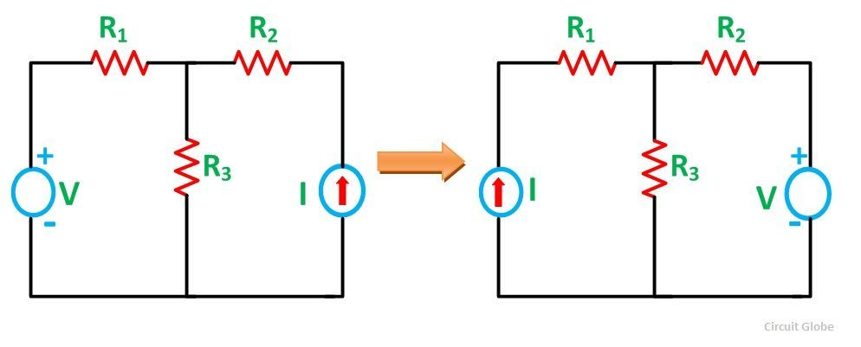
Reciprocity theorem
The reciprocity theorem states that the current at one point in a circuit due to a voltage at a second point is the same as the current at the second point due to the same voltage at the first. The reciprocity theorem is valid for almost all passive networks.
An example of reciprocity can be demonstrated using an asymmetrical resistive attenuator. An asymmetrical network is chosen as the example because a symmetrical network is fairly self-evidently reciprocal.

Slide 34
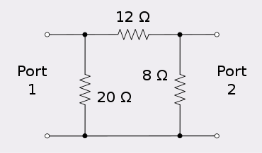
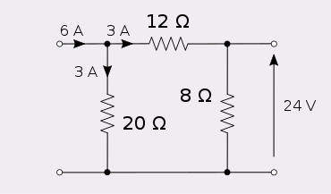
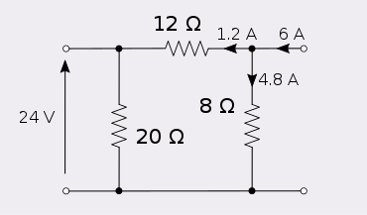
Injecting six amps into port 1 of this network produces 24 volts at port 2.
Injecting six amps into port 2 produces 24 volts at port 1.

Slide 35
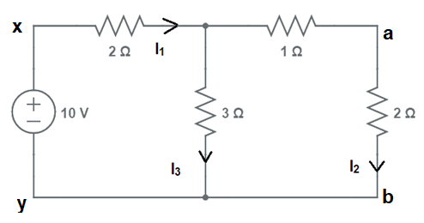
Exercise Problem 12: Verify reciprocity

Slide 36
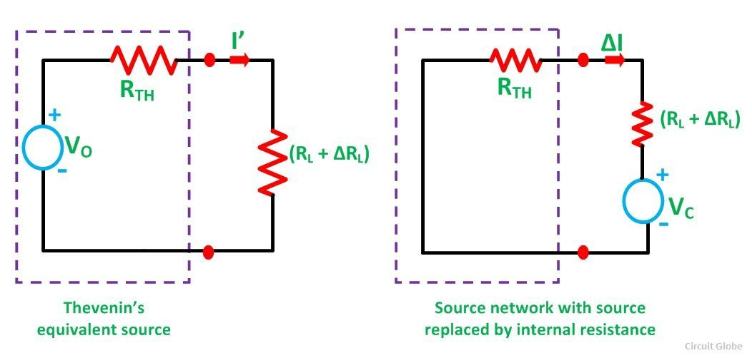

Compensation theorem
Compensation Theorem states that in a linear time-invariant network when the resistance (R) of an uncoupled branch, carrying a current (I), is changed by (ΔR), then the currents in all the branches would change and can be obtained by assuming that an ideal voltage source of (V_{C}) has been connected such that V_{C} = I (ΔR) in series with (R + ΔR) when all other sources in the network are replaced by their internal resistances.
V_{C} = I ΔRL and is known as compensating voltage.

Slide 37
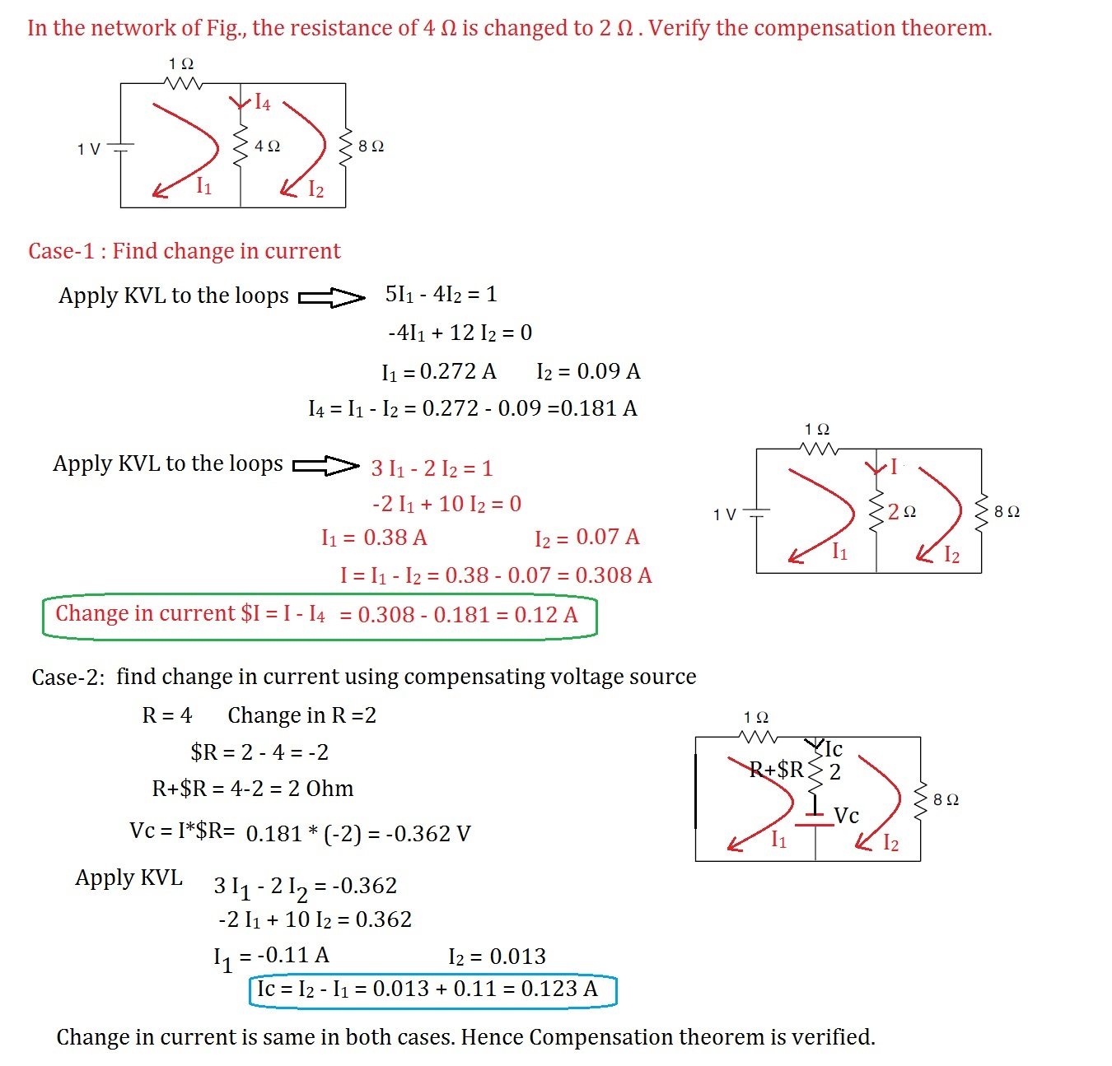
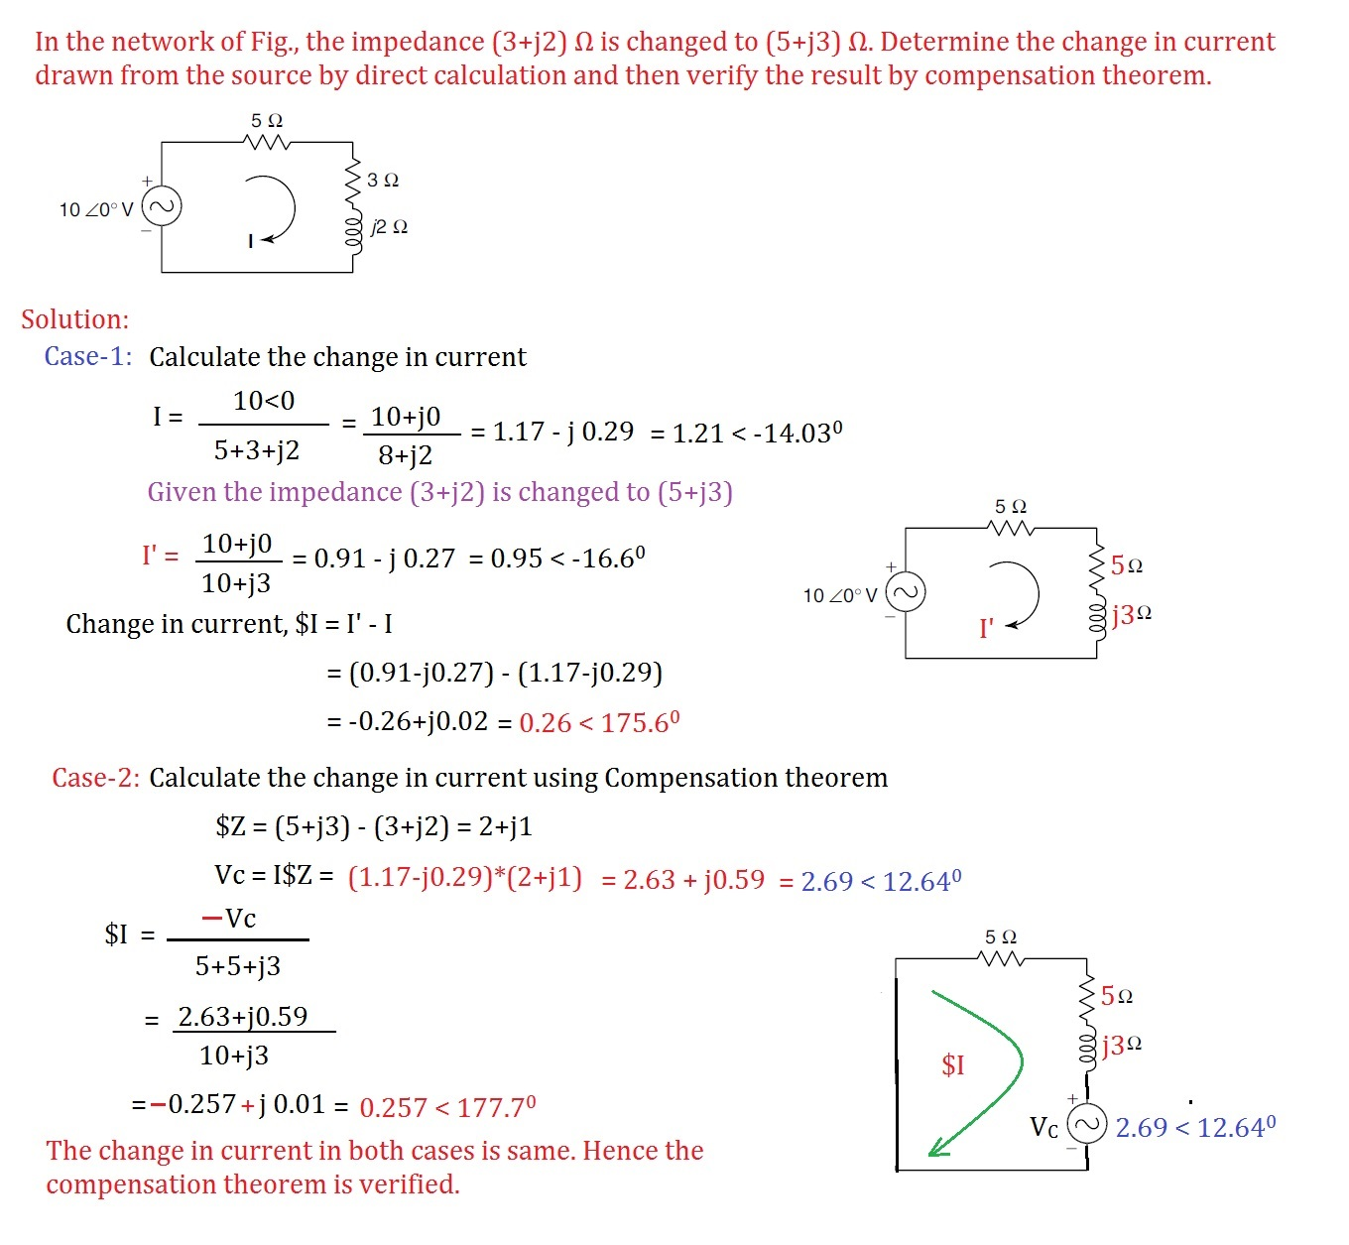

Slide 38
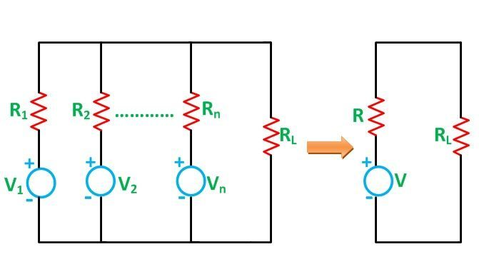
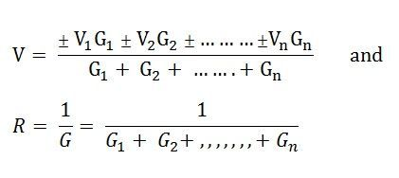

Milliman’s theorem
The Millman’s Theorem states that – when a number of voltage sources (V₁, V₂, V₃……… V_{n}) are in parallel having internal resistance (R₁, R₂, R₃………….R_{n}) respectively, the arrangement can replace by a single equivalent voltage source V in series with an equivalent series resistance R.
In other words; it determines the voltage across the parallel branches of the circuit, which have more than one voltage sources, i.e., reduces the complexity of the electrical circuit.

Slide 39
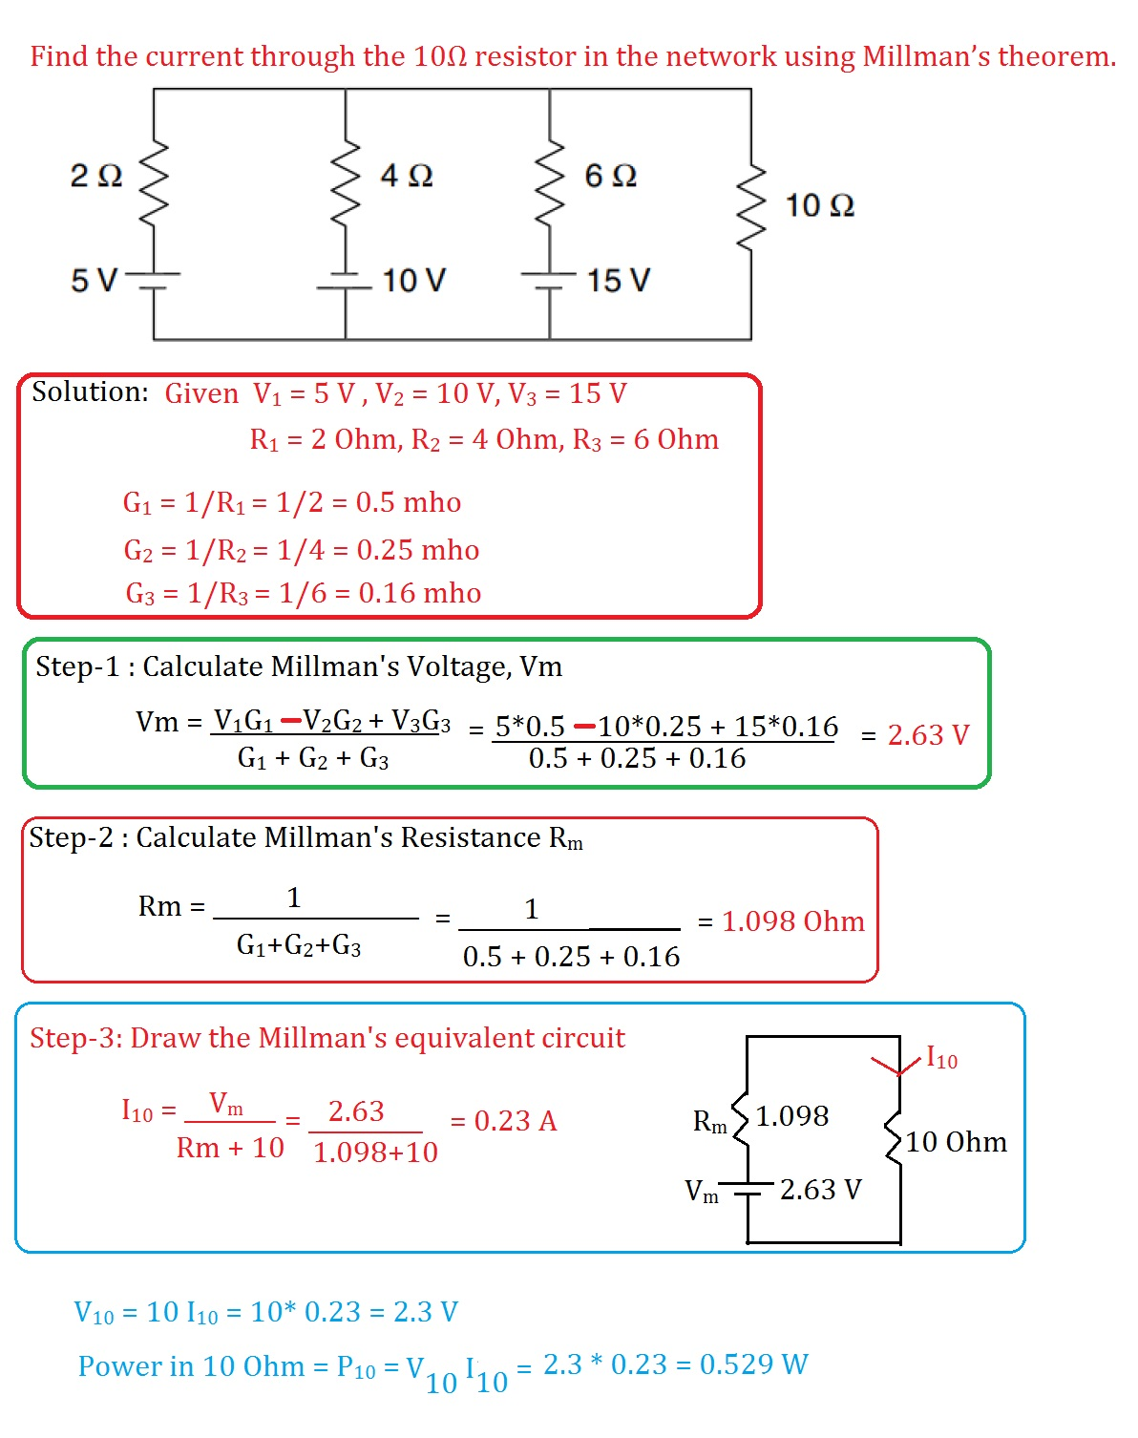
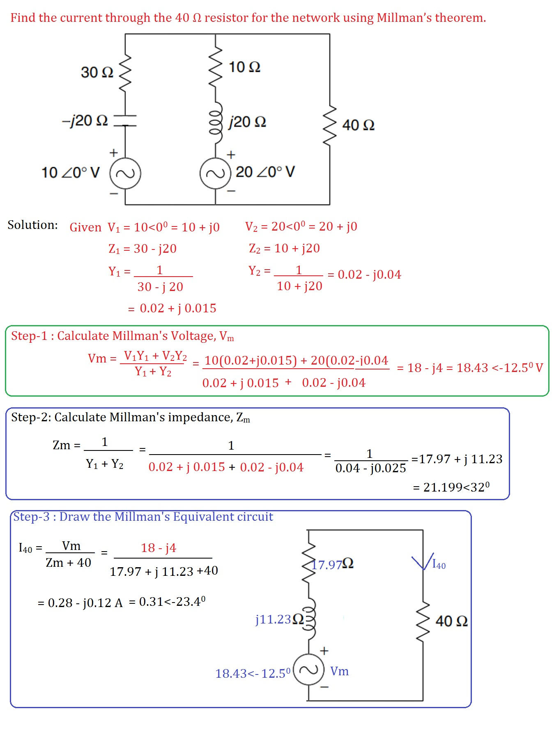

Slide 40
Duality and Dual Networks
Two circuits are said to be duals of one another if they are described by the same characterizing equations with dual quantities interchanged.

Slide 41
Place a node at the center of each mesh of the given circuit. Place the reference node (the ground) of the dual circuit outside the given circuit.
Draw lines between the nodes such that each line crosses an element. Replace that element by its dual
To determine the polarity of voltage sources and direction of current sources, follow this rule:
A voltage source that produces a positive (clockwise) mesh current has as its dual a current source whose reference direction is from the ground to the nonreference node.
The mesh (or nodal) equations of the original circuit are similar to the nodal (or mesh) equations of the dual circuit.

Slide 42
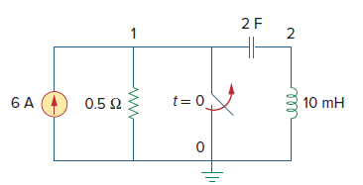
Produces clockwise mesh current so the dual current source direction is from reference node to Non reference Node
Produces clockwise mesh current so the dual current source direction is from reference node to Non reference Node
Produces Anti-clockwise mesh current so the dual voltage source polarity is Positive at Reference Node

